Slide 1

" MarketMaven - 3D Shopping Market Visualization with OpenGL"
Course: CSE 4208
Course Title: Computer Graphic Laboratory
Presented By
“
”
Swaraj Chandra Biswas
Roll: 1907069
Khulna University of Engineering & Technology, Khulna
Department of Computer Science and Engineering

Slide 2
Objectives
Introduction
Features
Output
TABLE OF
CONTENTS
[ 2 ]

Slide 3
Objectives
Build a 3D Shopping Center in OpenGL.
Enhance realism with lighting and textures.
Apply graphics concepts and showcase OpenGL's capabilities.
[ 3 ]

Slide 4
Introduction of Features:
Realistic 3D environment with aisles, shelves, products, and a cash counter.
Animations: Includes dynamic objects like rotating fans.
Lighting: Artificial lighting with point lights, spotlights, and directional lights.
Textures: Realistic textures applied to walls, floors, and products.
[ 4 ]

Slide 5
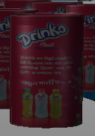
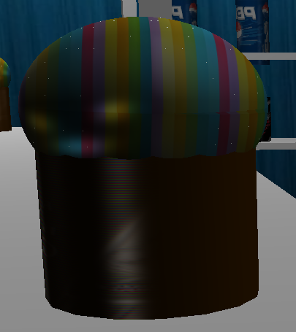
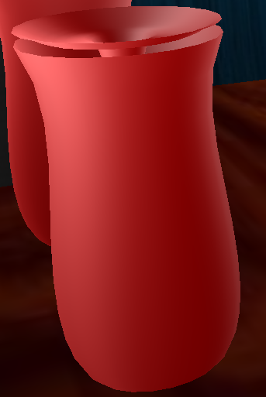

Shapes Used:
Fig 1: cylinder
Fig 2:Sphere
Fig 3: Objects with Bezier Curve
[ 5 ]

Slide 6
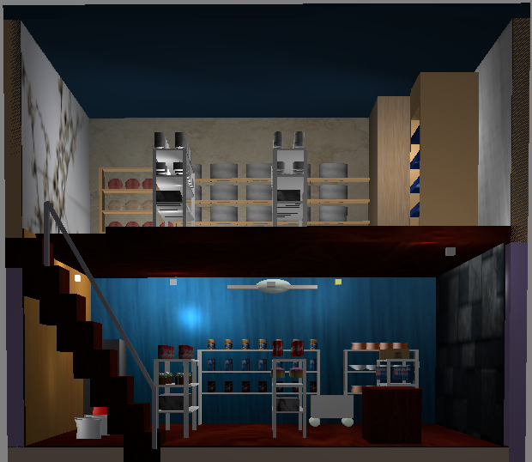
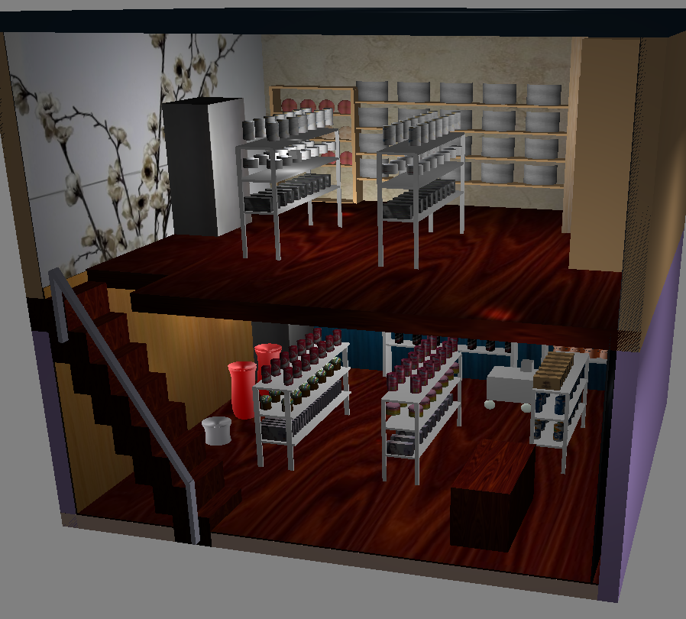
Final Output
movable objects (Fan,Cart)
[ 6 ]

Slide 7
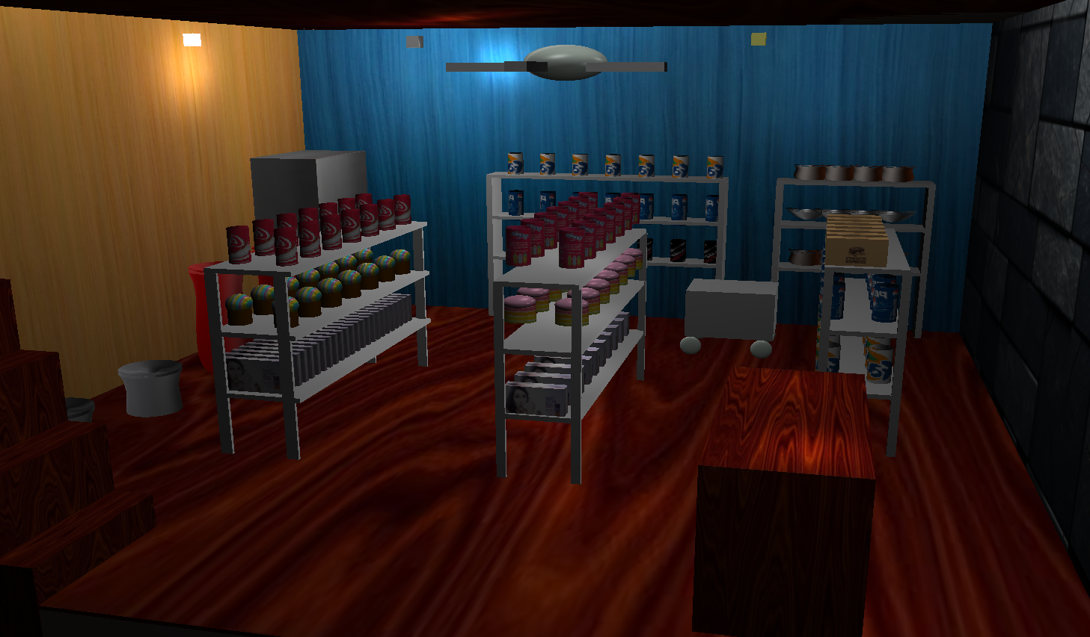
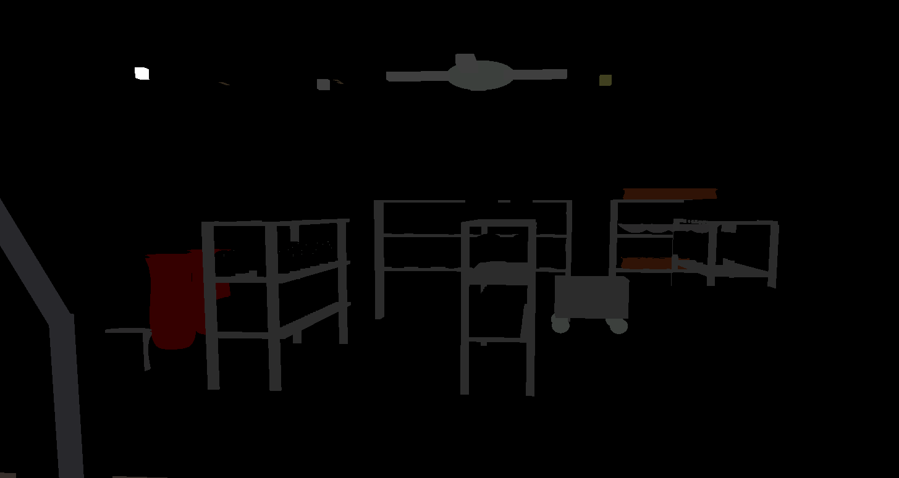
Directional Light Off/On
[ 7 ]

Slide 8
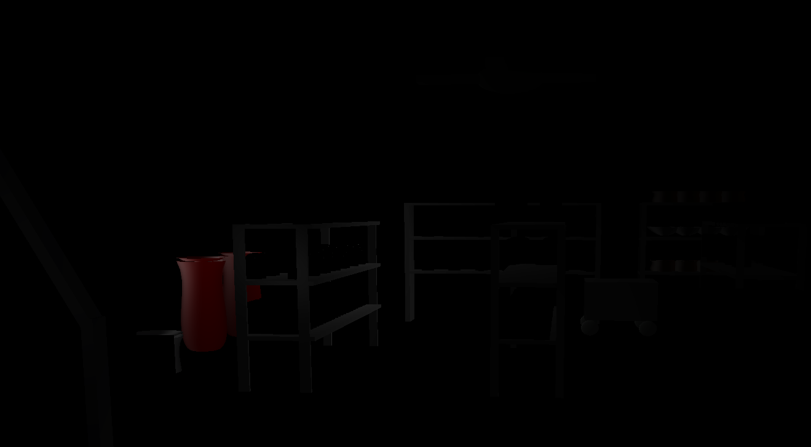
Spot Lights On

Slide 9
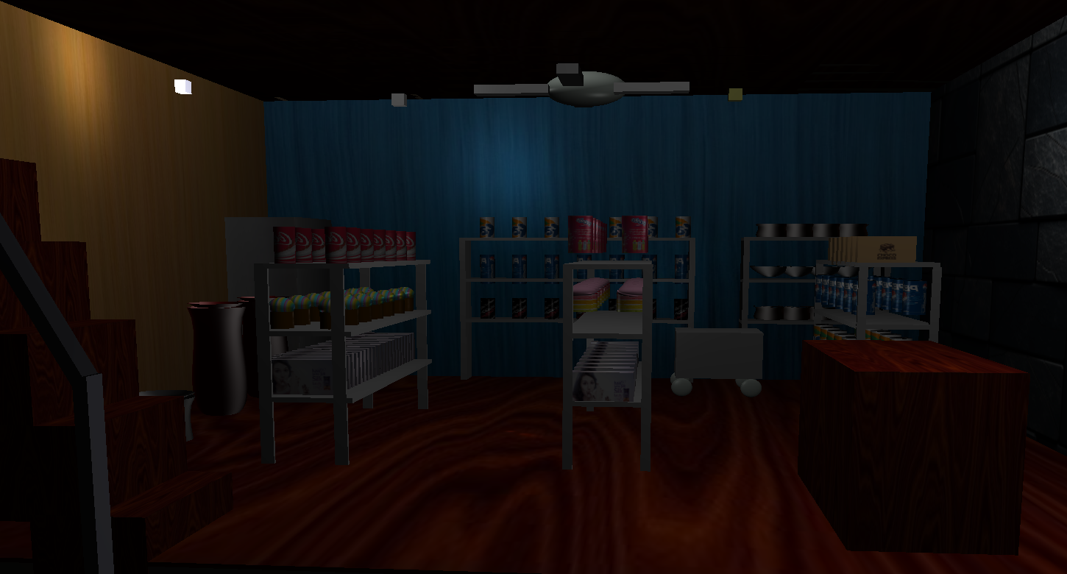
Point Lights (2,4) On

Slide 10
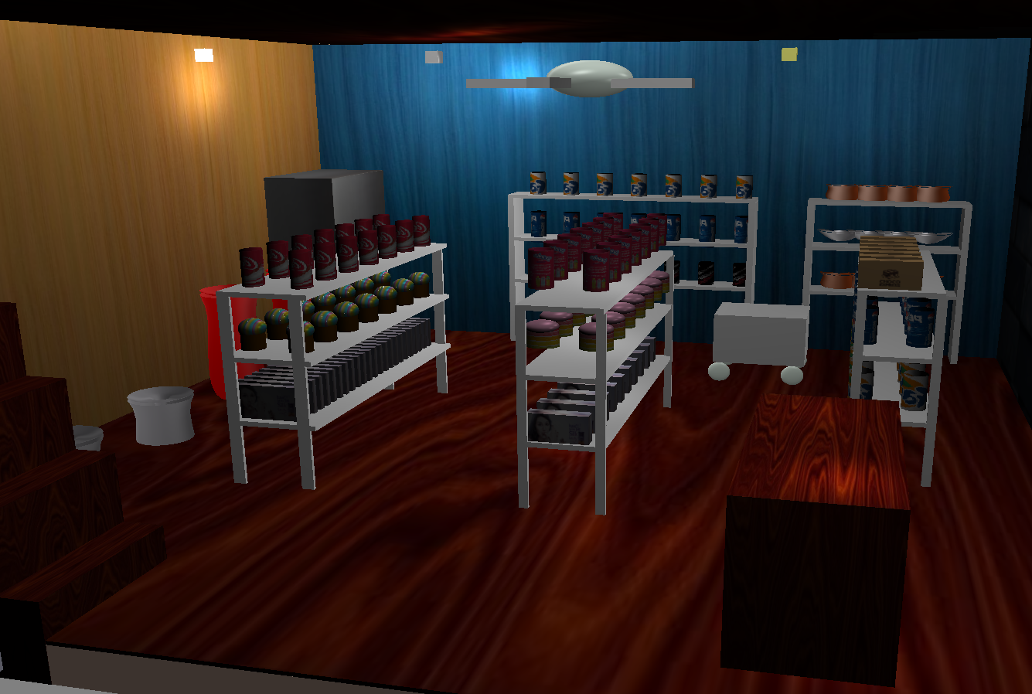
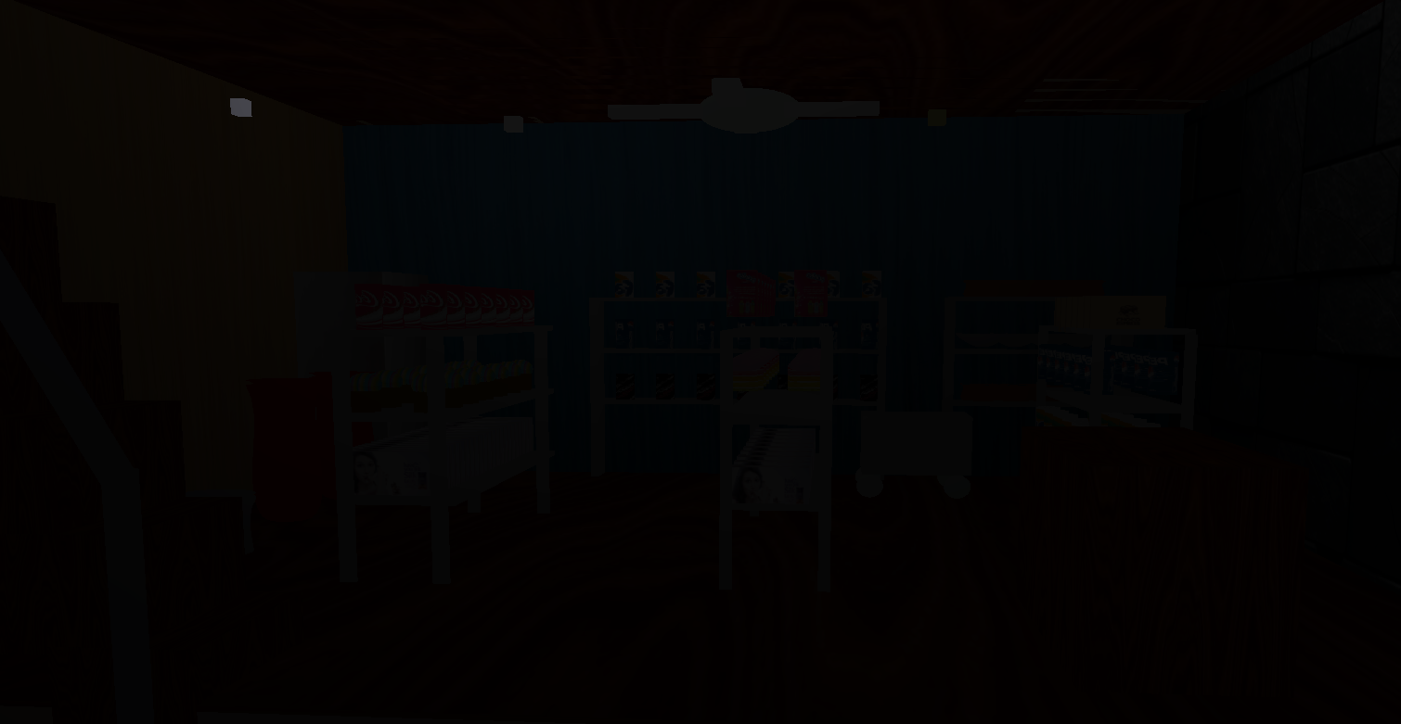

Output Ambient Light Off/On
[ 11 ]

Slide 11
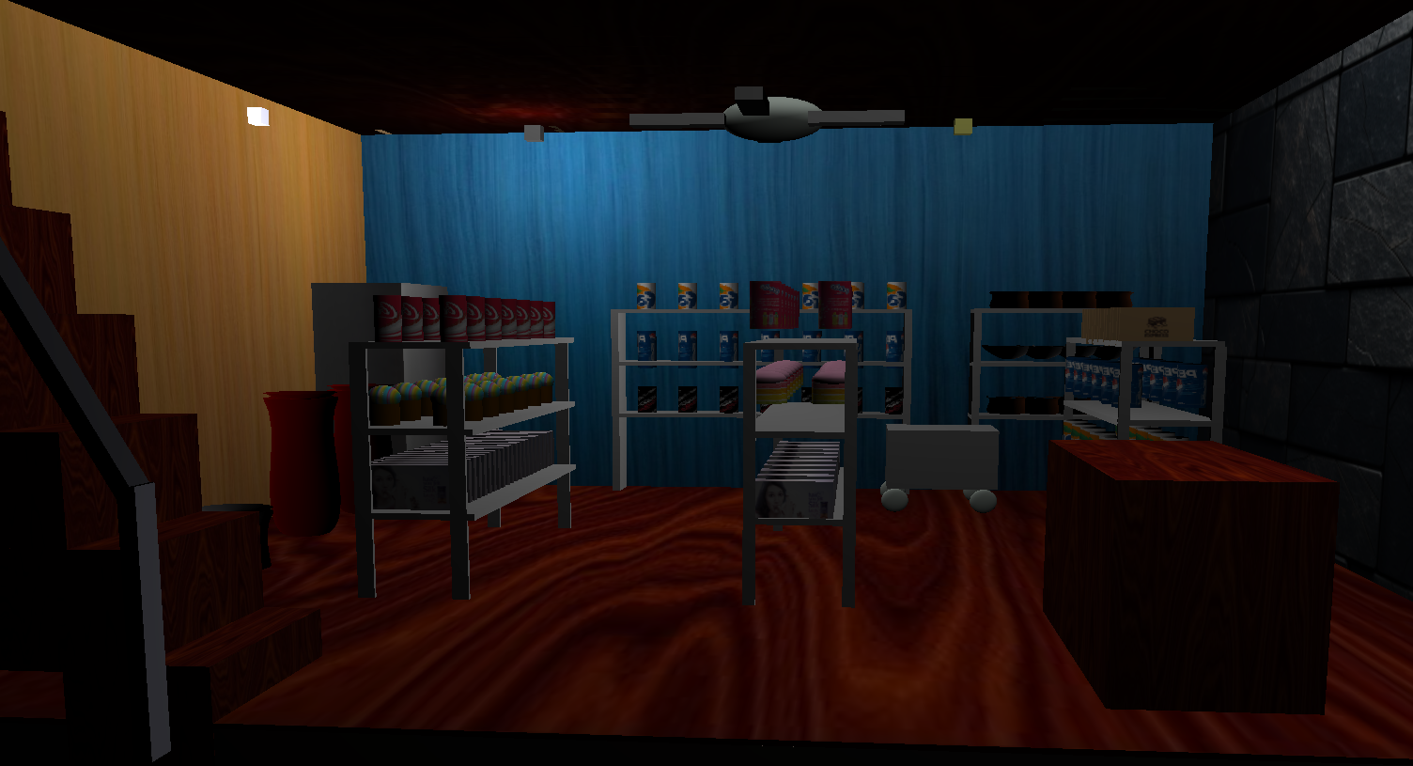
Output Diffuse Light On
[ 12 ]

Slide 12
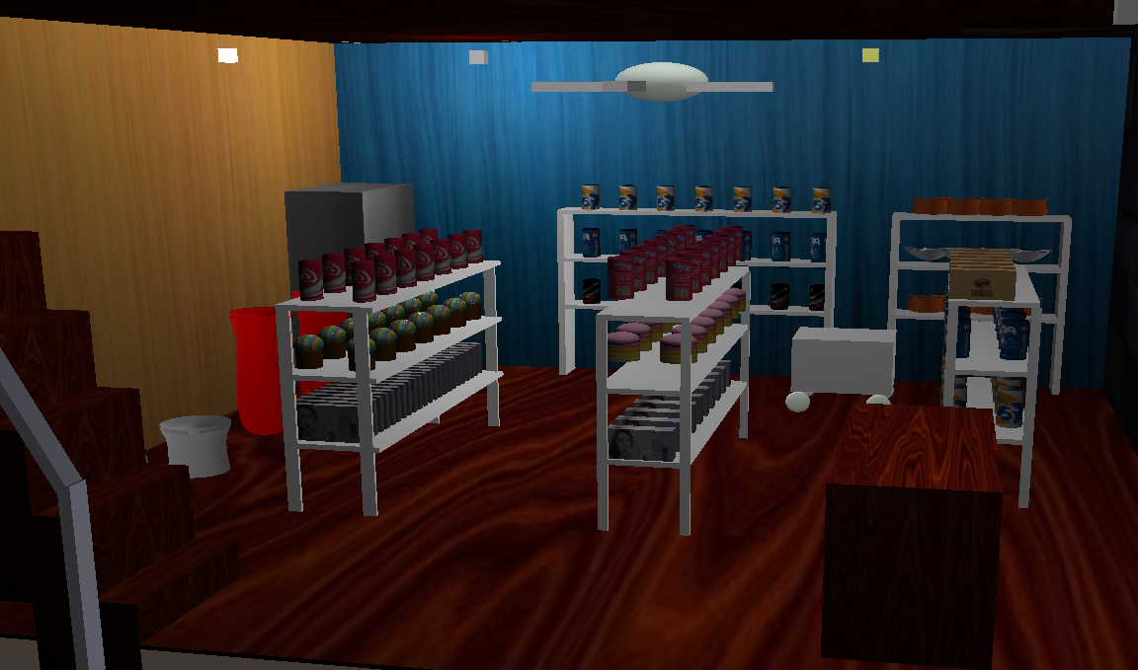
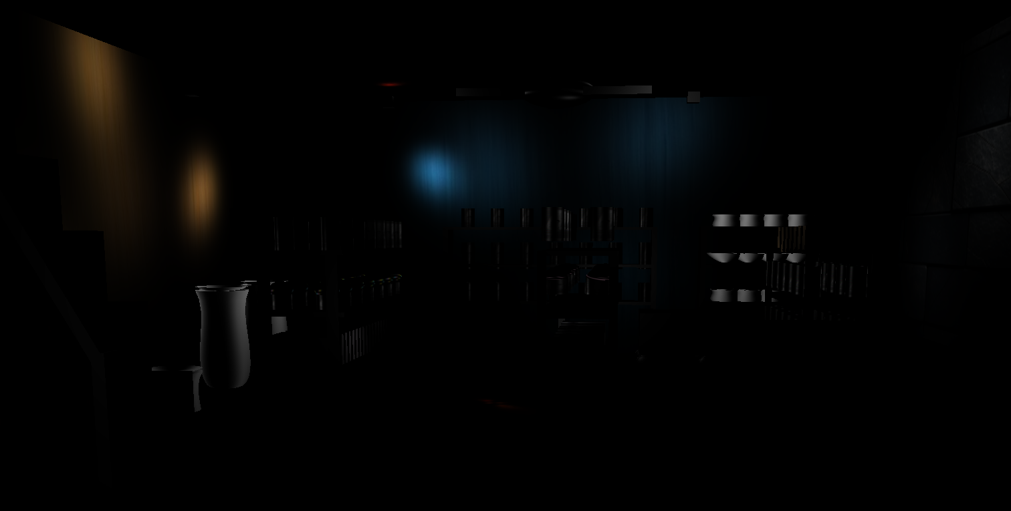
Output Specular Light Off/On:
[ 13 ]

Slide 13
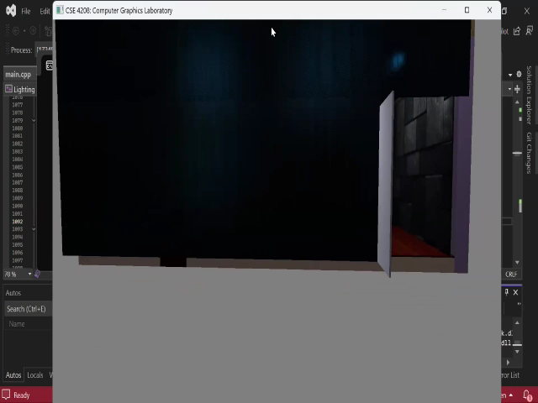
Project Video Presentation :
[ 14 ]

Slide 14
Functional Description of Keys
General Controls
ESC → Close the window
Camera Movement
1.G → Move forward
2.T → Move backward
3.F→ Move left
4.H→ Move right
5.E → Move down
6.Q → Move up
Lighting Functionality
Directional Light On and Off
Point Light 1 and 3 On and Off
Spot Light On and Off
Ambient Light On and Off
Diffuse Reflection On and Off
Specular Reflection On and Off
[ 15 ]

Slide 15

[ 16]

